Slide 1
GROUP WORK ASSIGNMENT
FOR INTRODUCTION TO COMPUTER NETWORKS
COURSE UNIT: IST 11O4
SEMESTER:1
LECTURER: MALE VINCENT
2026 YEAR: 1
BY GROUP 1
NAME | REGESTRATION NO. | STUDENT NO:
AINEBYONA VICTOR | 26/U/04227/PSA | 2600703692
ACHUDA FREDRICK | 26/U/29544/PSA | 2600729544
AKAMPURIRA IAN | 26/U/03698/PS | 2600703698
ODOI VINCENT | 26/U/04111/PSA | 2600704111
ABOKU GEORGE PHILIP | 26/U/03678/PSA | 2600703678
WAMANGA SHAMIHA | 26/U/04227/PS | 2600704227
OKELLO VIVIAN

Slide 2
Guided transmission media
Guided transmission media
Is a physical communication channel in which signals travel through a solid path, such as cables.
UNGUIDED TANSMISIION MEDIA
Unguided media transport electromagnetic waves without using a physical conductor. This type of communication is often referred to as wireless communication.

Slide 3
Qn.1 DIFFERENCE BETWEEN GUIDED AND UNGUIDED TRANSMISSION MEDIA
GUIDED TRANSMISSION MEDIA | UNGUIDED TANSMISIION MEDIA
Here, data travels through a physical cable or wire | Data travels through free space
It’s also called wired transmission media | It’s also called wireless transmission media
It’s more secure because physical access to a cable is required | It’s more vulnerable to interception
Installation can be difficult and expensive over a long distance | Easier to deploy where cables are difficult to install
Examples include; twisted cable, coaxial cable, and fiber-cable. | Examples include ; satellite communication, radio waves, microwaves

Slide 4
Qn.2. Using illustrations, discuss the various types of guided and unguided transmission media
GUIDED MEDIA, are those that provide a medium from one device to another
Include; Twisted-pair cable, coaxial cable, and fiber-optic cable.
TWISTED-PAIR CABLE:
A twisted pair consists of two conductors (normally copper), each with its own plastic insulation, twisted together.
One of the wires is used to carry signals to the receiver, and the other is used only as a ground reference.

Slide 5
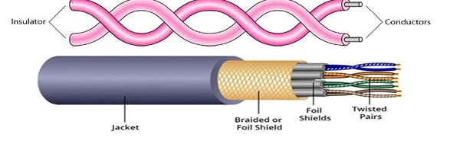
TWISTED-PAIR CABLE

Slide 6
Unshielded Versus Shielded Twisted-Pair Cable
The most common twisted-pair cable used in communications is referred to as unshielded twisted-pair (UTP).
STP cable has a metal foil or braided mesh covering that encases each pair of insulated conductors. Although metal casing improves the quality of cable by preventing the penetration of noise or crosstalk, it is bulkier and more expensive.

Slide 7

The most common UTP connector is RJ45
(RJ stands for registered jack)

Slide 8
Applications
Twisted-pair cables are used in telephone lines to provide voice and data channels. Local-area networks, such as l0base-t and l00base-t, also use twisted-pair cables.
Coaxial Cable
Coaxial cable (or coax) carries signals of higher frequency ranges than those in twisted pair cable. Coax has a central core conductor of solid or stranded wire (usually copper) enclosed in an insulating sheath, which is, in turn, encased in an outer conductor of metal foil, braid, or a combination of the two. The outer metallic wrapping serves both as a shield against noise and as the second conductor, which completes the circuit. This outer conductor is also enclosed in an insulating sheath, and the whole cable is protected by a plastic cover

Slide 9
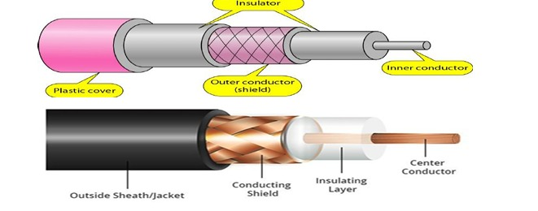
The most common type of connector used today is the Bayone-Neill-Concelman (BNE), connector.

Slide 10
APPLICATIONS coaxial cable was widely used in analog telephone networks, digital telephone networks cable TV networks also use coaxial cables.
Another common application of coaxial cable is in traditional Ethernet lans
Fiber-Optic
cable a fiber-optic cable is made of glass or plastic and transmits signals in the form of light. light travels in a straight line as long as it is moving through a single uniform substance.
if a ray of light traveling through one substance suddenly enters another substance (of a different density), the ray changes direction. bending of light ray

Slide 11
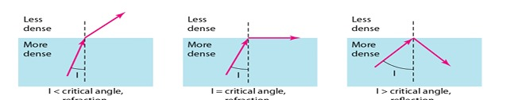
Optical fibers use reflection to guide light through a channel. A glass or plastic core is surrounded by a cladding of less dense glass or plastic.

Slide 12

Optical fiber cable

Slide 13
UNGUIDED MEDIA/ WIRELESS
Unguided media transport electromagnetic waves without using a physical conductor. This type of communication is often referred to as wireless communication.
  Radio waves
  Microwaves
  Infrared

Slide 14
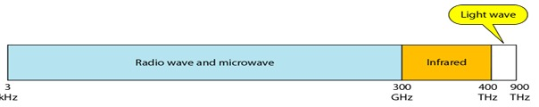
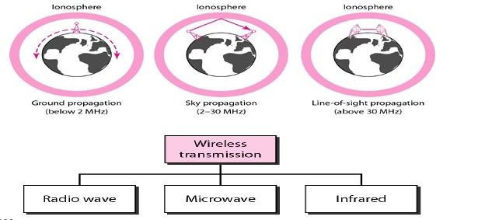
Unguided signals can travel from the source to destination in several ways: ground propagation, sky propagation, and line-of-sight propagation, as shown in figure radio wave

Slide 15
Radio Waves
  Electromagnetic waves ranging in frequencies between 3 KHZ and 1 GHZ are normally called radio waves. Radio waves are omni directional. When an antenna transmits radio waves, they are propagated in all directions. This means that the sending and receiving antennas do not have to be aligned. A sending antenna sends waves that can be received by any receiving antenna. The omni directional property has a disadvantage, too. The radio waves transmitted by one antenna are susceptible to interference by another antenna that may send signals using the same frequency or band.

Slide 16
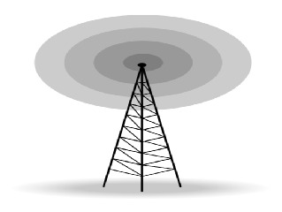
Omni directional Antenna
Radio waves use omnidirectional antennas that send out signals in all directions. Based on the wavelength, strength, and the purpose of transmission, we can have several types of antennas.
Figure shows an omnidirectional antenna.

Slide 17
Microwaves
Electromagnetic waves having frequencies between 1 and 300 ghz are called microwaves. Microwaves are unidirectional. The sending and receiving antennas need to be aligned. The unidirectional property has an obvious advantage. A pair of antennas can be aligned without interfering with another pair of aligned antennas
Unidirectional Antenna
Microwaves need unidirectional antennas that send out signals in one direction. Two types of antennas are used for microwave communications: the parabolic dish and the horn

Slide 18
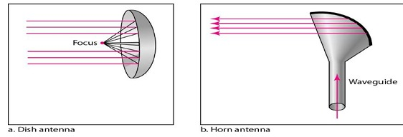
Infrared
Infrared waves, with frequencies from 300 GHZ to 400 THZ (wavelengths from 1 mm to 770 nm), can be used for short-range communication. Infrared waves, having high frequencies, cannot penetrate walls. This advantageous characteristic prevents interference between one system and another; a short range communication system in one room cannot be affected by another system in the next room.

Slide 19
When we use our infrared remote control, we do not interfere with the use of the remote by our neighbors. Infrared signals useless for long-range communication. In addition, we cannot use infrared waves outside a building because the sun's rays contain infrared waves that can interfere with the communication.
Applications:
Infrared signals can be used for short-range communication in a closed area using line-of-sight propagation.

Slide 20
Medium | signal | bandwidth
Twisted pair | Electrical | moderate
Coaxial | Electrical | Very high than twisted
Fiber optic | light | Very high

Slide 21
QN.3 DISCUSS THE CRETARIA FOR SELECTING NETWORK TRANSMISION MEDIA.
Band width/data rate
How much data can it carry? For high speed needs like video streaming use fiber optic (up to tbps). For low speed office work ,twisted pair is enough (100mps-1gbps)
DISTANCE/ATTENUATION
How far can signal go without becoming weak?
Twisted pair -100m
Coaxial- -500m
Fiber optic -100km+
Wireless depends on power

Slide 22
Cost
Initial cost +maintenance cost
Twisted pair is cheapest, fiber is most expensive to buy and install,wireless has no cabling cost but needs access points.
Electromagnetic interference(emi) and Noise immunity
Twisted pair and coax are affected by electrical noise from motors, power lines.
Fiber optic is Not affected by Emi at all , brst for industrial areas.
Wireless is affected by weathe , walls other signals.

Slide 23
Security
How easy is it to tap?
Wireless and twisted pair ; easy to tap
Coaxial difficult
Fiber optical very difficult, best for banks , military.

Slide 24
Ease of installation and maintenance
Twisted pair very easy to install.
Fiber needs skilled technicians, special tools for splicing.
Wireless, easy but needs configuration.
Physical environment
Where will it be installed? Indoor, outdoor, underground, wireless for mobile users or buildings where you cannot run cables.

Slide 25
Number of Devices / topoLOgY
If many devices in a devices in a building, structured cabling with twisted pair is better.
FUTURE SCALABILITY
Will you need more speed in future? Fiber is future-proof.
SAFETY
In areas with high voltage or fire risk, use fiber because it does not carry electricity.

Slide 26
QN.4) What is a noise in the network transmission media, discuss the various types of nose in network transmission media.
NOISE
Defined as an unwanted signals with in the wanted signal.
A)noise whose sources are external to the receiver.
B)noise created within the receiver itself.
A)EXTERNAL NOISE
Noise created outside the receiver.
Examples.
Atmospheric.
Extra-terrestrial.
Industrial.

Slide 27
Atmospheric noise.
Caused by lightening discharge in thunderstorm and other natural electrical disturbances.
They affect a wide spectrum due to its random nature.
This noise becomes when operated in the vhf(30mhz) or above.
EXTRA-TERRESTRIAL NOISE
Solar noise is from the sun. It can have a temperature exceeding 6000 degree and a such temperature it radiates energy with some noise.
Cosmic is noise from the stars.

Slide 28
Industrial noise
Noise from cars, aircrafts, industrial machines ,etc
It can rage from 1 to 600mhz
This noise can be transmitted based on band signals.
B)INTERNAL NOISE
Noise generated inside transmitters, receivers and communication cables.
It’s a function of so many factors such as resistance, bandwidth and temperature.
Far more disturbing is the thermal noise.

Slide 29
Crosstalk
Crosstalk is an unwanted couple between signal paths.
It can occur by electrical coupling between nearby twisted pairs
Experienced by anyone who, while using the telephones, has been able to hear another conversation.
IMPULSE NOISE.
Non-continuous noise consisting of irregular pulses or noise spikes of short duration and of relatively high amplitude.
It is generated from a variety of causes.
External electromagnetic disturbances, such as lighting .

Slide 30
Fault and flaws in the communications system.
Impulse noise is generally only a minor annoyance for analog data .
However, impulse noise is primary source of error in digital data.

Slide 31
Intermodulation noise.
Noise due to signals of different frequencies sharing the same transmission medium,
The effect of intermodulation noise is to produce signals at a frequency that is the sum or difference of the two original.
This derived signal could interfere with an intended signal at the frequency

Slide 32
Noise figure
Signal-to-Noise(S/N) ratio at the I/P to S/Nat the O/P
Nose figure F = (S/N)in/(S/N)out
F is a direct measure of the S/N ratio degradation caused by the system.
Noise factor
Noise figure expressed in decibels
NF =10logf

